Slide 1

Building Microservices Applications on Azure Service Fabric
Jeffrey Richter
Materials: http://bit.do/ServiceFabric (case-sensitive)
Microsoft Azure
Service Fabric

Slide 2
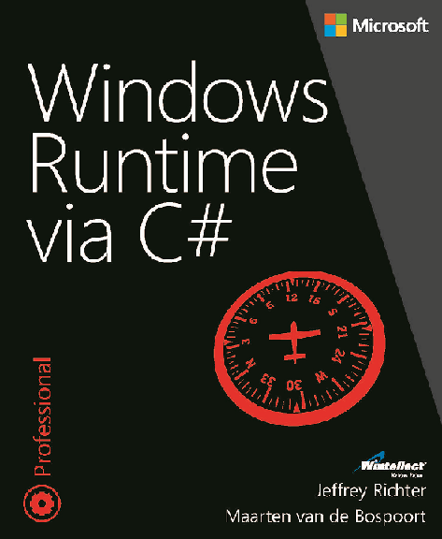
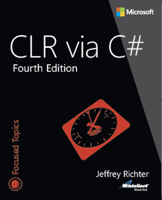
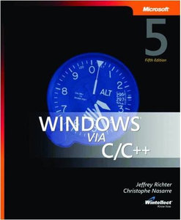



Jeffrey Richter: Microsoft Software Engineer, Wintellect Co-Founder, & Author
JeffreyR@Microsoft.com
www.linkedin.com/in/JeffRichter
@JeffRichter

Slide 3
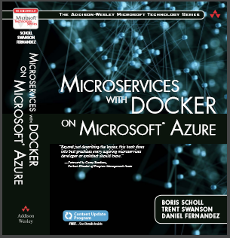
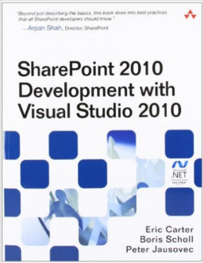
Boris Scholl: Principal PM, Azure Compute
Author and Speaker
Passionate about Microservices
Looking after containerized workloads in
Azure
bscholl@Microsoft.com
http://www.linkedin.com/in/bscholl

Slide 4
Agenda
Timeslot | Topic
9:00 - 9:15 | Welcome and logistics
9:15 – 10:30 | Introduction to Service Fabric Azure Compute Stack Service Fabric vs Cloud Services Service Fabric Clusters
10:45 – 12:00 | Application Packaging, Health and Lifecycle Application and Service Types Package format Service Fabric health Upgrading Service Fabric Applications
12:00 – 13:00 | Lunch
13:00 – 13:30 | Container integration
13:30 – 15:00 | Stateless & Stateful Reliable Services
15:15 – 16:45 | Patterns and sample architectures

Slide 5

Service Fabric: A Microservices Platform
Build Applications with many Languages, Frameworks, & Runtimes
Service Fabric: Microservices Platform
LifecycleMgmt
Independent Scaling
Rolling Upgrades
Always On
Availability
Resource
Efficient
Stateless/
Stateful
Public Clouds
On Premises
Private cloud
Developer

Slide 6
What is Service Fabric
Platform for distributing/managing/scaling your services
  Service Fabric components are free of charge
  Egagement: https://github.com/azure/service-fabric-issues
Supported clouds (Windows, soon Linux)
  Microsoft: Azure & Azure Stack
  Other: On-premises & other public clouds
  OneBox: Development PC (via SF SDK)
Programming models
  Guest executables: Any Windows app (any language & frameworks)
  Service host executables: Reliable Services (.NET)
    Service Fabric SDK: http://aka.ms/ServiceFabricSDK

Slide 7
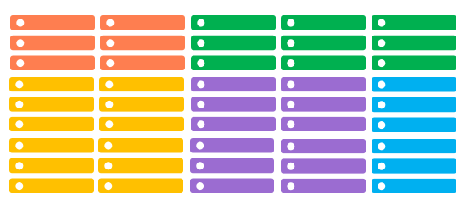
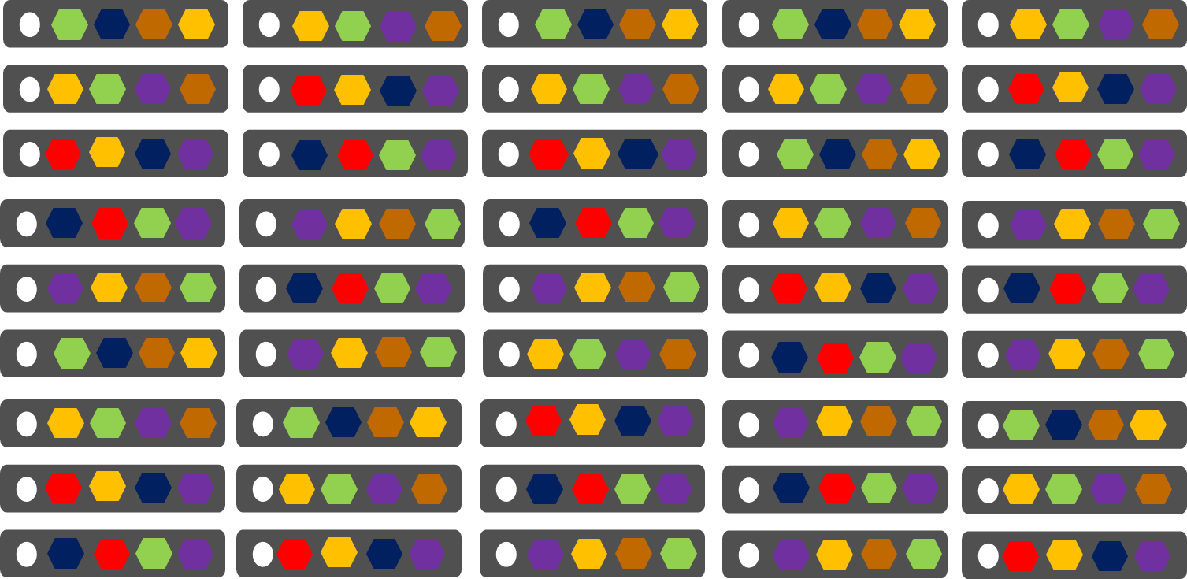
Cloud Services vs Service Fabric
Azure Cloud Services
(Web & Worker Roles)
Azure Service Fabric
(Services)
  Each role/instance per VM
  Slow deployment & upgrades
  Slow to scale role instances up/down
  Emulator for development
  Many service instances share a PC/VM
  Fast deployment & upgrades
  Fast to scale service instances up/down
  OneBox cluster for development

Slide 8
Azure’s Next Generation Cloud Platform
Web
Apps
Mobile
Apps
Media
App Service
Service Fabric Apps
ACS
Batch
Service Fabric
(VMs and Containers)
Apprenda CloudFoundry
Jelastic
SCALR RightScale,
Mesos
Swarm
Kubernetes
VM Extensions
Physical Machines
& Other Clouds
VMs and VM Scale Sets
Azure Stack
Azure Public Cloud

Slide 9
Service Fabric Container Integration
Support for Docker, Windows and Hyper-V containers
Running guest containers in Service Fabric
  Container does not contain SF runtime
  Uses container host feature
  Uses Service Fabric Cluster management and resource scheduling capabilities
Building containerized Service Fabric applications
  Container contains SF runtime
  Build stateless and stateful SF services
  Uses Service Fabric Cluster management and resource scheduling capabilities

Slide 10
Azure Resource Manager
Azure Resource Manager
Application Lifecycle Container
Declarative Solution for Deployment and Configuration
Consistent Management Layer
Azure Resource Groups
Tightly coupled containers of multiple resources of similar or different types
Resource Group is a unit of management
  Deployment, Update, Delete
  Identity
  Metering, billing, quota
RESOU
R
CE G
R
OUP

Slide 11
Power of Repeatability
SQL-A
Instantiation of repeatable config.
Configuration → Resource Group
Azure Templates can:
Ensure Idempotency
Simplify Orchestration
Simplify Roll-back
Provide Cross-Resource Configuration and Update Support
Azure Templates are:
Source file, checked-in
Specifies resources and dependencies
(VMs, WebSites, DBs) and connections
(config, LB sets)
Parameterized input/output
Website
[SQL CONFIG] VM (2x)
DEPENDS ON SQL
DEPENDS ON SQL
SQL - A
Website
Virtual
Machines
SQL
C
ONFIG

Slide 12

Service Fabric Cluster with 5 Nodes
Datacenter (Azure, Amazon, On-Premises, …)
PC/VM #2
Service Fabric
Your code, etc.
PC/VM #3
Service Fabric
Your code, etc.
(Port: 19080)
PC/VM #1
Your code, etc.
Service Fabric
PC/VM #4
Load Balancer
Your code, etc.
Service Fabric
Your code, etc.
PC/VM #5
Web Request
(Port: 80/443/?)
Service Fabric
Your code, etc.
*SF supports 1,000s of nodes

Slide 13
Securing Node Endpoints
Securing
  SF Node ↔ SF Node communication
    Azure: Key Vault, Virtual Network
    Other: Certificate
  Outside → Cluster management node endpoint
    Azure: Key Vault
  Outside → your code’s node endpoint
    Up to you
  Service Accounts and RunAs
    Up to you (defined in the application manifest)

Slide 14
Securing a Service Fabric Cluster
Service Fabric clusters should always be secured
  Default setting when creating a cluster through the portal
Use certificates to secure access
  X509 Server certificates
Use Azure Key Vault
  Create a Key Vault with EnabledForDeployment enabled
  DELETE?: Key Vault needs to be in the same region as the SF cluster
  Upload cert to key vault as a secret
  Microsoft Compute Resource Provider gets the secret stored in the Key Vault
  and places it in the node’s specified Certificate Store

Slide 15
Setting-up a
Cluster in Azure

Slide 16
Service Fabric’s Infrastructure Services
Service | Description
Cluster Manager | Cluster management (REST [HTTP=19080], PowerShell/FabricClient [TCP=19000])
Failover Manager | Rebalances service instances as nodes come/go
Naming | Registry mapping service instances → endpoints
Fault Analysis | Let’s you inject faults to test your services
Image Store | Contains your app packages (not on OneBox)
Upgrade | Upgrades SF on nodes (Azure only)

Slide 17
Service Fabric’s Infrastructure Services
Cluster Manager (ports 19080 [REST] & 19000 [TCP])
Performs cluster REST & PowerShell/FabricClient operations
Failover Manager
Rebalances resources as nodes come/go
Naming
Maps service instances to endpoints
Image store (not on OneBox)
Contains your Application packages
Upgrade Service (Azure only)
Coordinates upgrading SF itself with Azure’s SFRP
C
Node #2
F
C
N
I
Node #1
N
C
I
F
Node #3
C
F
U
I
Node #5
N
F
U
Node #4
U
N
I
U

Slide 18
Node Processes
PC/VM
OneBox
[testing]
FabricHost.exe
[Auto-starts at boot]
Fabric.exe
[Inter-node communication]
Fabric.exe
[Inter-node communication]
Node
Node
FabricGateway.exe
[Cluster communication]
FabricGateway.exe
[Cluster communication]
Your App’s Services
Ex: ASP.NET or other .exe
[Exposes public endpoint(s)]
Your App’s Services
Ex: ASP.NET or other .exe
[Exposes public endpoint(s)]

Slide 19
Service Fabric Explorer

Slide 20
Service Instance Environment Variables
Fabric_NodeId=a4022a6606950d760bba3d9d4937c970
FabricActivatorAddress=localhost:24792
Fabric_RuntimeConnectionAddress=localhost:19016
Fabric_ApplicationId=Type-SFAuction_App0
Fabric_ApplicationName=fabric:/SFAuction
Fabric_ServicePackageName=Pkg-SFAuction.Svc.RestApi
Fabric_ServicePackageInstanceId=130930156141866701
Fabric_ServicePackageVersionInstance=1.0:1.0:130930156116829394
Fabric_CodePackageName=Code
Fabric_CodePackageInstanceId=130930156141866701
Fabric_ApplicationHostType=Activated_SingleCodePackage
FabricPackageFileName=C:\SfDevCluster\Data\Node.2\Fabric\Fabric.Package.current.xml
TMP=C:\SfDevCluster\Data\_App\Node.2\Type-SFAuction_App0\temp
TEMP=C:\SfDevCluster\Data\_App\Node.2\Type-SFAuction_App0\temp
HostedServiceName=HostedService/Node.2_Fabric
Fabric_ApplicationHostId=cab5b00a-8b54-4eb8-aaf7-e462e83682ff

Slide 21
Application Packaging
& Deployment

Slide 22
Defining Application Types & Service Types
An application is a collection of services
  In Service Fabric terms, we call these application types & service types
  So, an application type is a collection of service types
Cluster
eStore App Type
“Contoso” eStore App
“Fabrikam” eStore App
Image Store
Gallery Svc Type
“G” Gallery Svc
“G” Gallery Svc
Payment Svc Type
“P” Payment Svc
“P” Payment Svc

Slide 23
App Pkg Dir & its ApplicationManifest.xml File
C:\eStoreAppTypePkg
│ ApplicationManifest.xml
│
├───GalleryServicePkg
│ │ ServiceManifest.xml
│ │
│ └───CodePkg
│ Gallery.exe
│ GalleryLib.dll
│ Setup.bat
│
└───PaymentServicePkg
│ ServiceManifest.xml
│
└───CodePkg
Payment.exe
<ApplicationManifest
ApplicationTypeName="eStoreAppType"
ApplicationTypeVersion="1.0" ...>
<ServiceManifestImport>
<ServiceManifestRef
ServiceManifestName="GalleryServicePkg"
ServiceManifestVersion="1.0" ... />
<ServiceManifestRef
ServiceManifestName="PaymentServicePkg"
ServiceManifestVersion="1.0" ... />
...
</ServiceManifestImport>
</ApplicationManifest>

Slide 24
Service Pkg Dir & its ServiceManifest.xml File
C:\eStoreAppTypePkg
│ ApplicationManifest.xml
│
├───GalleryServicePkg
│ │ ServiceManifest.xml
│ │
│ └───CodePkg
│ Gallery.exe
│ GalleryLib.dll
│
└───PaymentServicePkg
│ ServiceManifest.xml
│
└───CodePkg
Payment.exe
<ServiceManifest Name="GalleryServicePkg"
Version="1.0">
<ServiceTypes>
<StatelessServiceType
ServiceTypeName="GalleryServiceType" ... >
</StatelessServiceType>
</ServiceTypes>
<CodePackage Name="CodePkg" Version="1.0">
<EntryPoint> <ExeHost>
<Program>Gallery.exe</Program>
</ExeHost> </EntryPoint>
</CodePackage>
<Resources> <Endpoints>
<Endpoint Name="GalleryEndpoint"
Type="Input" Protocol="http" Port="8080" />
</Endpoints> </Resources>
</ServiceManifest>
Use <ContainerHost> container support

Slide 25
Runtime Relationships
Cluster
Management, Billing (VMs), Geolocation, Multitenancy
1+ Named Applications
Isolation, Multitenancy, Unit of versioning/config
1+ Named Services
Code package(s), Multitenancy (w/o isolation)
Stateless: 1 Partition
No value
Stateful: 1+ Partitions
Addressability, Scale
1+ Instances
Scale, Availability
1+ Replicas
Availability
You can dynamically start/remove named apps/services & instances/replicas
A named service’s partition count is fixed over its lifetime
A named service’s instance/replica count applies to all of its partitions

Slide 26
Creating Apps, Services, Partitions, & Instances
Registered & provisioned
  App type=“A” with Service type=“S”
Create 1 named app
Creates 2 named services
Node #2
f:/A1/S1, P₁, I₂
Node #1
f:/A1/S1, P₁, I₁
App Type | App Version | App Name
“A” | 1.0 | fabric:/A1
Node #3
f:/A1/S1, P₁, I₃
Node #5
f:/A1/S2, P₁, I₁
f:/A1/S2, P₂, I₂
App Name | Service Type | Service Name | # Partitions | # Instances
fabric:/A1 | “S” | fabric:/A1/S1 | 1 | 3
fabric:/A1 | “S” | fabric:/A1/S2 | 2 | 2
Node #4
f:/A1/S2, P₁, I₂
f:/A1/S2, P₂, I₁
NOTE: When using SF programming models, instances from same named app/service are in the same process

Slide 27
“fabric:/Contoso”
Named App
“fabric:/Contoso/Gallery”
Named Svc (Stateless)
“fabric:/Contoso/Payment”
Named Svc (Stateful)
Partition-1
Partition-1
Partition-2
Instance-1
Replica-1
Replica-1
Instance-2
Replica-2
Replica-2
Replica-3
Replica-3

Slide 28
Deploy Application Type
& Create App Instance

Slide 29
PowerShell App Pkg & Named App/Service Ops
Copy-ServiceFabricApplicationPackage (to image store)
Register-ServiceFabricApplicationType (in image store)
Remove-ServiceFabricApplicationPackage (from image store)
New-ServiceFabricApplication (named app)
New-ServiceFabricService (named svc)
Remove-ServiceFabricService (named svc)
Remove-ServiceFabricApplication (named app & its named svcs)
Unregister-ServiceFabricApplicationType (from image store)
  No named app can be running

Slide 30
Health

Slide 31
Health Entities, Events, & States
Each entity has set of health events
Each event has a health state:
  OK: No issues
  Warning: An issue that may fix itself
  (ex: unexpected delay)
  Error: Issue requiring action
When evaluating an entity
  SF aggregates entity’s & descendants’
  events against policy
  Deployed Apps → Warning
  Applications → Error
Cluster
Nodes
Applications
Deployed
Applications
Services
Deployed Service
Packages
Partitions
Instances/
Replicas

Slide 32
Health Policies
Default: entity is healthy if it & children are healthy
  In a world with regular failures, 20% Error might be considered Warning
Health policies define
what healthy means
  Cluster policy can be in
  cluster manifest
  App policy can be in
  application manifest
  Or, you can pass custom policy when querying health
<FabricSettings>
<Section Name="HealthManager/ClusterHealthPolicy">
<Parameter Name="MaxPercentUnhealthyApplications" Value="0"/>
<Parameter Name="MaxPercentUnhealthyNodes" Value="20"/>
</Section>
</FabricSettings>
<Policies>
<HealthPolicy MaxPercentUnhealthyDeployedApplications="20">
<DefaultServiceTypeHealthPolicy
MaxPercentUnhealthyServices="0"
MaxPercentUnhealthyPartitionsPerService="10"
MaxPercentUnhealthyReplicasPerPartition="0"/>
<ServiceTypeHealthPolicy ServiceTypeName="FrontEndSvcType"
MaxPercentUnhealthyServices="0"
MaxPercentUnhealthyPartitionsPerService="20"
MaxPercentUnhealthyReplicasPerPartition="0"/>
</HealthPolicy>
</Policies>

Slide 33
A Watchdog Submitting
Health Reports

Slide 34
Health Failure Examples
Cluster: Nodes not responding to periodic heartbeat
  Applications: Partition could not be placed
    Service: Failed to place replica(s)
      Partition: Below target instance count
        Replica: Replica taking too long to open/close
  Node: Node down, certificate expiration, load capacity violation
  Deployed Applications: Failed to download code package
    Deployed Service Packages: Service Package Activation, Code Package Activation, Service type registration, Download, Upgrade validation

Slide 35
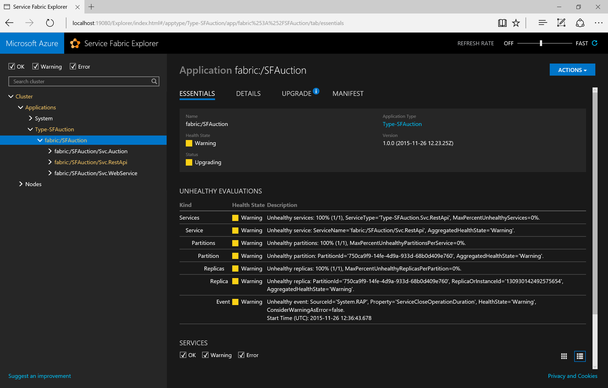

Slide 36
Example Health Failures
Cluster health failures
  Nodes not responding to periodic heartbeat
    Report: SourceId=System.Federation, Property=Neighborhood
    Action: Check communication within cluster
Node health failures
  Node Down
    Report: SourceId=System.FM (failover manager), Property=State
    Action: Wait for upgrade to complete; if taking too long, investigate
  Certificate Expiration
    Report: SourceId=System.FabricNode, Property=Certificate XXX
    Action: Update certificate
  Load Capacity Violation
    Report: SourceId=System.PLB (placement load balancer), Property=Capacity
    Action: View current node capacity & update metrics
Application health failures (System.CM=Cluster Manager)
Service failures (System.FM=Failover Manager)
  Unplaced replicas violation
    Report: SourceId=System.FM, Property=State
    Action: Check service constraints

Slide 37
Example Health Failures
Partition failures (System.FM)
  Replicas below minimum
    Report: SourceId=System.FM, Property=State
    Action: Check bug in service code’s Open/ChangeRole
Replica failures (System.RA [Reconfiguration agent])
  Replica takes too long to open
    Report: SourceId=System.RA, Property=RepliaOpenStatus
    Action: Check service’s Open code
  Slow service API call
    Report: SourceId=System.RAP or System.Replicator, Property=[Name of slow API]
    Action: Check service’s API code (possible unhandled exception)
  Replica queue full warning
    Report: SourceId=System.Replicator, Property=[Primary | Secondary]ReplicationQueueStatus

Slide 38
Example Health Failures
DeployedApplication (System.Hosting)
  Activation
    Report: SourceId=System.Hosting, Property=Activation (includes rollout version)
  Download
    Report: SourceId=System.Hosting, Property=Download
DeployedServicePackage (System.Hosting)
  Service Package Activation
    Report: SourceId=System.Hosting, Property=Activation
  Code Package Activation
    Report: SourceId=System.Hosting, Property=CodePackageActivation
  Service type registration
    Report: SourceId=System.Hosting, Property=ServiceTypeRegistration
  Download
    Report: SourceId=System.Hosting, Property=Download
  Upgrade validation
    Report: SourceId=System.Hosting, Property=FabricUpgradeValidation

Slide 39
Submitting Health Reports
Have “watchdog” periodically check service instance
    Watchdog code/process can be in or out of the cluster
    Keep watchdog simple and “bug-free”
Submit health reports via PowerShell, REST, .NET API
  .NET API batches reports and sends ~30 seconds (default)
Submit helpful health reports that…
  Prevent downtime, reduce issue investigation time, improve customer satisfaction
    Ex: Diminishing disk space, bad perf, big queue size
    Agents can poll health and take action (Ex: delete old files, send e-mails)
Note: Reports are deleted when entity deleted
  To outlive entity, submit report on parent entity

Slide 40
Submitting a Health Report

Slide 41
What’s in a Health Report
For each entity, SF stores 1 health report per SourceId/Property
Mandatory Data | Description
Entity | Cluster, Node, App, Service, Partition, Replica, Deployed App, Deployed Service Pkg
SourceId | String uniquely identifies reporter
Property | Category (ex: “Storage” or “Connectivity”)
HealthState | Ok, Warning, Error
Optional Data | Default | Description
Description | “” | Human readable info
TimeToLive | Infinite | # seconds before report is expired
RemoveWhenExpired | False | Useful if TTL != Infinite. If false, report’s entity is in Error; else report removed after expiration.
SequenceNumber | Auto- generated | Increasing integer. Use to replace old reports when reporting state transitions.

Slide 42
What’s in a Health Event
SF wraps a health event around a health report
Property | Description
HealthInformation | The original health report
SourceUtcTimetamp | The time the health report was originally submitted
LastModifiedUtcTimestamp | The last time the report was modified
IsExpired | True if TTL expired and RemoveWhenExpired=false
LastOkTransitionAt LastWarningTransitionAt LastErrorTransitionAt | These give a history of the event’s health states. Ex: Alert if !Ok > 5 minutes

Slide 43
Health Report Submission Guidance
Never submit report not related to health
  Health is not a generic reporting mechanism
Avoid reporting on state transitions because you’ll have to synchronize state across failures
Avoid SequenceNumber; accept auto-generated
Always clean up reports when no longer valid
  Ex: Errors affect upgrades
  So, have watchdog report periodically with TTL & RemoveWhenExpired=false
  If watchdog fails, event’s IsExpired=true & entity’s health is Error
  To have report self-expire, send with TTL & RemoveWhenExpired=true

Slide 44
Upgrading a
Named Application

Slide 45
Updating Your App’s Service’s Code
Put new code in code package
Update ver strings
(#s are not required)
Copy new app package to image store
Register new app type/
version
Select named app(s) to upgrade to new version
<ApplicationManifest ApplicationTypeName="DemoAppType"
ApplicationTypeVersion="3.0" ...>
<ServiceManifestImport>
<ServiceManifestRef ServiceManifestName="WebServer"
ServiceManifestVersion="2.0" .../>
</ServiceManifestImport>
</ApplicationManifest>
C
B2
B1
<ServiceManifest Name="WebServer" Version="2.0">
<ServiceTypes>
<StatelessServiceType ServiceTypeName="WebServer" ...>
<Extensions> ... </Extensions>
</StatelessServiceType>
</ServiceTypes>
<CodePackage Name="CodePkg" Version="1.1">
<EntryPoint> ... </EntryPoint>
</CodePackage>
<Resources><Endpoints> ... </Endpoints></Resources>
</ServiceManifest>
A

Slide 46
Upgrade Domains
Prevent complete service outage while upgrading
  More UDs → less loss of scale but more time to upgrade
  # UD set when cluster created via cluster manifest; ARM template
    Default=5; 20% down at a time
  IMPORTANT: 2 versions of your code run side-by-side simultaneously
    Beware of data/schema/protocol changes; use 2-phase upgrade
Below shows 9 instances spread across 5 UDs
UD #0
UD #1
UD #2
UD #3
UD #4
Instance-1
Instance-2
Instance-3
Instance-4
Instance-5
Instance-6
Instance-7
Instance-8
Instance-9

Slide 47
Fault Domains
fd:/DC1/R1/B1
fd:/DC1/R1/B2
fd:/DC1/R1/B3
fd:/DC1/R2/B1
fd:/DC1/R2/B2
fd:/DC1/R2/B3
fd:/DC2/R1/B1
fd:/DC2/R1/B2
fd:/DC2/R1/B3
fd:/DC2/R2/B1
fd:/DC2/R2/B2
fd:/DC2/R2/B3
…
Isolate cluster from a single point of
hardware failure (fault)
  Determined by hardware topology (datacenter, rack, blade)
DC1
DC2
DC3
R1
R2
R1
R2
R1
R2
B1
B1
B1
B1
B1
B1
B2
B2
B2
B2
B2
B2
B3
B3
B3
B3
B3
B3

Slide 48
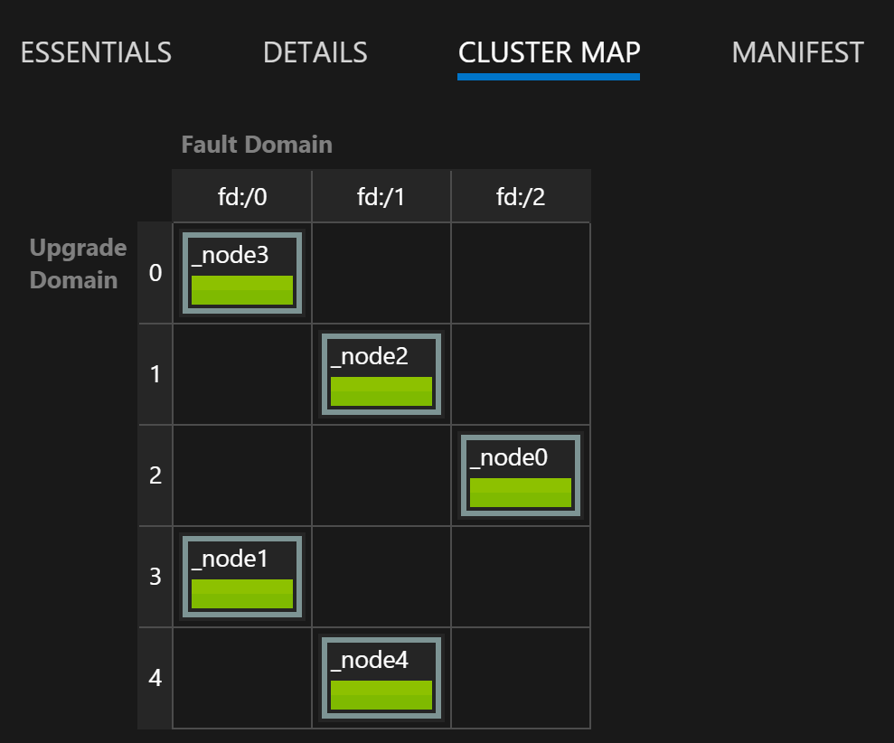
Service Fabric Explorer’s Cluster Map
Example shows Cluster
in Azure and how nodes spread across fault/upgrade domains
Note: Azure’s SFRP doesn't support X-DC clusters today

Slide 49
Start-ServiceFabricApplicationUpgrade
Parameter | Default | Description
ApplicationName | N/A | Application Instance name
TargetApplicationTypeVersion | N/A | The version string you want to upgrade to
FailureAction | N/A | Rollback (to last version) or Manual (stop upgrade & switch to manual)
UpgradeDomainTimeoutSec | Infinite | If any UD takes more than this time, FailureAction
UpgradeTimeout | Infinite | If all UDs take more than this time, FailureAction
HealthCheckWaitDurationSec | 0 | After UD, SF waits this long before initiating health check
UpgradeHealthCheckInterval | 60 | If health check fails, SF waits this long before checking again (set in cluster manifest; not PowerShell)
HealthCheckRetryTimeoutSec | 600 | Maximum time SF waits for app to be healthy
HealthCheckStableDurationSec | 0 | How long app must be healthy before upgrading next UD

Slide 50
Optional Health Criteria Policies
Parameter | Default | Description
ConsiderWarningAsError | False | Warning health events are considered errors stopping the upgrade
MaxPercentUnhealthyDeployedApplications | 0 | TODO: Max unhealthy before app is declared unhealthy
MaxPercentUnhealthyServices | 0 | Max service instances unhealthy before app is declared unhealthy
MaxPercentUnhealthyPartitionsPerService | 0 | Max partitions unhealthy before service instance is declared unhealthy
MaxPercentUnhealthyReplicasPerPartition | 0 | Max partition replicas unhealthy before partition is declared unhealthy
UpgradeReplicaSetCheckTimeout | Infinite 900 (rollback) | Stateless: How long SF waits for target instances before next UD Stateful: How long SF waits for quorum before next UD
ForceRestart | False | Forces service restart when updating config/data

Slide 51
Upgrading a
Named Application

Slide 52
Managing Named Application Upgrades
Get progress via Get-ServiceFabricApplicationUpgrade
  Most problems are timing related
    Instances/replicas not going down quickly
    UDs not coming up in time
    Failing health checks
If FailureAction is “Manual”, you can:
Optional: After all named apps upgrade,
unregister old app type
Action | PowerShell Command
Rollback | Start-ServiceFabricApplicationRollback
Start next UD | Resume-ServiceFabricApplicationUpgrade
Resume monitored upgrade | Update-ServiceFabricApplicationUpgrade

Slide 53
Updating a
Named Service

Slide 54
Update a Named Service
Update-ServiceFabricService let’s you
  Scale up/down by changing instance count
  Report metric
  Set Placement constraints and policy
  Update a named service’s properties

Slide 55
Updating a Named Service

Slide 56
The Cluster
Resource Manager

Slide 57
Node Placement Properties & Capacities
Node Placement Properties & Constraints
  Apply placement properties to all nodes indicating type of RAM, disk, etc.
  Apply placement constraint when starting/updating a named service
Node Capacities & Service Load Metric Values
  Apply capacity limits to desired nodes indicating size of RAM, disk, etc.
  Specify metrics to balance & default load in ServiceManifest.xml
    Override default load when starting/updating a named service
  A named service instance can report load dynamically with SF prg models

Slide 58
Node Placement Properties & Constraints
Lets you constrain instances to nodes with specific values
  Hardware: Type of CPU, RAM, disk, network, GPU, etc.
  Other: Geolocation, network access/DMZ
You should set properties on all nodes via
Azure ARM or ClusterManifest.xml
    <Property Name="Continent" Value="Americas"/> ← (string/double)
Apply constraint via ServiceManifest.xml or
New/Update-ServiceFabricService
  "(Constraint == Americas) && (FrontEnd == false)"
Predefined: NodeType
NodeName FaultDomain
UpgradeDomain

Slide 59
Node Capacities & Service Load Metric Values
Set resource limits (size of disk, RAM, etc.) on desired
nodes via Azure ARM or ClusterManifest.xml
  <Capacity Name="Disk" Value="100"/> ← (int)
Specify metrics to balance & default load values via ServiceManifest.xml
  <LoadMetric Name="Disk" Weight="High" DefaultLoad="50"/>
Override for a named service via New/Update-SFService
  Name, Weight (Importance: Zero, Low, Medium, High), Instances’ value
  @("Disk,High,75", …)
  SF prg models: code calls ReportLoad to update instance’s values dynamically

Slide 60
DEMO: Cluster Resource Manager
12 Node Cluster
6 in America, 6 in Europe; 2 FE & 4 BE in each Datacenter
1
2
3
4
4 Instances, FE=true
3 Instances,
C=America,
FE=false
D=50GB
3 Instances,
C=America,
FE=false,
D=50GB
D=100GB
#1
Continent: America
FrontEnd: true
Disk: 100GB
#2
Continent: America
FrontEnd: true
Disk: 100GB
#7
Continent: Europe
FrontEnd: true
Disk: 100GB
#8
Continent: Europe
FrontEnd: true
Disk: 100GB
1
2
1
#3
Continent: America
FrontEnd: false
Disk: 100GB
#4
Continent: America
FrontEnd: false
Disk: 100GB
#9
Continent: Europe
FrontEnd: false
Disk: 100GB
#10
Continent: Europe
FrontEnd: false
Disk: 100GB
3
2
3
#5
Continent: America
FrontEnd: false
Disk: 100GB
#6
Continent: America
FrontEnd: false
Disk: 100GB
#11
Continent: Europe
FrontEnd: false
Disk: 100GB
#12
Continent: Europe
FrontEnd: false
Disk: 100GB
3

Slide 61
VIPs, DIPS, and PIPs
Virtual IP: Public IP (1 per VNET; dynamic or 5 static)
Dynamic IP: Per-VM’s NIC(s), assigned by VNET submask
Public Instance-level IP: Internet → VM instance (no LB)
VNET
VM #1
NIC
(DIP)
NIC
(DIP)
VM #2
NIC
(DIP)
NIC
(DIP)

Slide 62
Placement Constraints & Load Metrics

Slide 63
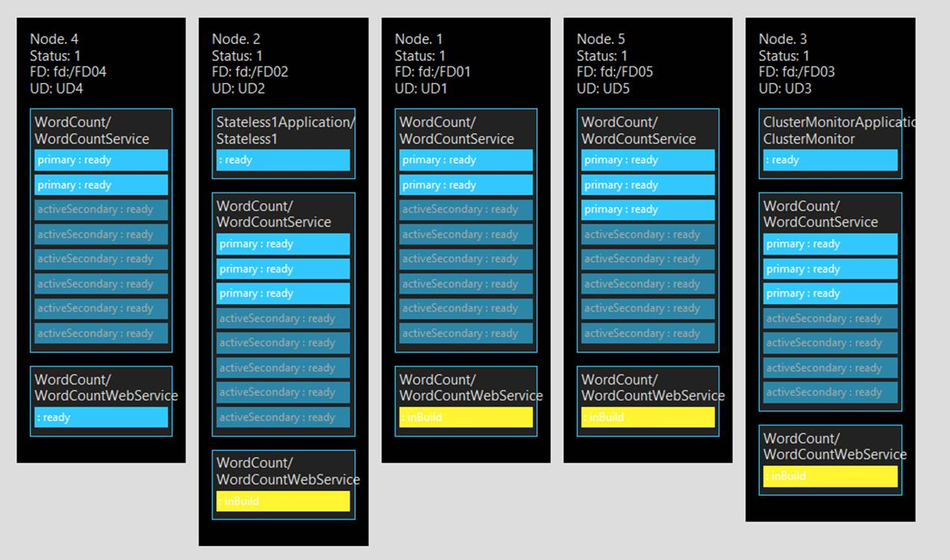

Slide 64
Static configuration
  ClusterManifest.xml NodeType:
    PlacementProperties: "FrontEnd" = "true", "Continent" = "Americas"
    Capacities: "Disk"="100"
  Web service’s ServiceManifest.xml, StatelessServiceType:
    PlacementConstraint: (FrontEnd == true)
  Database service’s ServiceManifest.xml, StatefulServiceType
    Load Metrics: "Disk" = "50“ (GB for Primary & Secondary replicas)
Dynamic operations:
  With cluster down, update ClusterManifest.xml, & start up cluster (Admin):
  New-ServiceFabricNodeConfiguration -ClusterManifestPath C:\...\ClusterManifest.xml
  Deploy App package & start WebSite named service with 3 instances (Visual Studio F5)
  Start Database service 1st Americas tenant (See Disk load metrics in SFX under partition’s DETAILS):
  New-ServiceFabricService -ApplicationName fabric:/Prb -ServiceName fabric:/Prb/DB-1 -ServiceType DatabaseType
  -MinReplicas 3 -TargetReplicas 3 -Stateful -PlacementConstrains "Constraint == Americas && FrontEnd == false"
  Start Database service 2nd Americas tenant:
  New-ServiceFabricService -ApplicationName fabric:/Prb -ServiceName fabric:/Prb/DB-2 -ServiceType DatabaseType
  -MinReplicas 3 -TargetReplicas 3 -Stateful -PlacementConstrains "Constraint == Americas && FrontEnd == false"
  Start Database service 3rd Americas tenant (fails, out of resources):
  New-ServiceFabricService -ApplicationName fabric:/Prb -ServiceName fabric:/Prb/DB-3 -ServiceType DatabaseType
  -MinReplicas 3 -TargetReplicas 3 -Stateful -PlacementConstrains "Constraint == Americas && FrontEnd == false"
  Node 5: Make instance report 100GB causing replica to move

Slide 65
Node Movement
Periodically, each node’s reconfiguration agent (RA) sends load values to the PRB service
PRB performs
  Constraint check
    If any constraint/capacity violated, moves instances to fix
    This generally helps balance the cluster
  Balance check
    If cluster not balanced, moves instances (not being moved) to fix
A service instance can report load against any metric but only specified metrics can be balanced against
  Useful when upgrading code to report new metrics
  Follow this up with an Update-ServiceFabricService

Slide 66
Balancing Threshold
Set in clusterManifest.xml
<Section Name="MetricBalancingThresholds">
<!-- ratio of MostLoaded to LeastLoaded node -->
<Parameter Name="Metric1" Value="2"/>
<Parameter Name="Metric2" Value="3.5"/>
</Section>
Activity threshold
<Section Name="MetricActivityThresholds">
<!-- Don’t balance until load is > value -->
<!-- Prevents churn during bootstrap] -->
<Parameter Name="Memory" Value="1536"/>
</Section>
Move cost: Zero, Low, Medium, and High.
  this.ServicePartition.ReportMoveCost(MoveCost.Medium);

Slide 67
Simulated Annealing
SF uses simulated annealing to improve the cluster’s balance
If cluster is imbalanced:
  Give cluster’s current balance a score
  Generate a random, valid move and give it s score; keep best score
    Repeat until some time period has elapsed
  If final score is better than cluster’s current score, initiate new balancing to incrementally improving the cluster’s balance

Slide 68
Frequency of Placement Calculations
By default, Resource Manager’s PRB
  Contemplates what to check every 1/10th second for batching changes
  Considers placement checks every 1 second
  Considers constraint checks every 1 second
  Considers balancing every 5 seconds
Allows for aggressive constraint checks but less aggressive balancing
ClusterManifest.xml: (JMR- What about in Azure?)
<Section Name="PlacementAndLoadBalancing">
<Parameter Name="PLBRefreshGap" Value="0.1" />
<Parameter Name="MinPlacementInterval" Value="1" />
<Parameter Name="MinConstraintCheckInterval" Value="1" />
<Parameter Name="MinLoadBalancingInterval" Value="300" />
</Section>

Slide 69
Testability

Slide 70
Testability
Two main test scenarios provided out of the box
  Chaos tests
  Failover tests
Tools
  C# APIs (System.Fabric.Testability.dll)
  PowerShell commandlets (runtime required)

Slide 71
Testability Actions
Actions | Description | Managed API | Powershell Cmdlet | Graceful/ UnGraceful Faults
CleanTestState | Removes all the test state from the cluster in case of a bad shutdown of the test driver. | CleanTestStateAsync | Remove-ServiceFabricTestState | Not Applicable
InvokeDataLoss | Induces data loss into a service partition. | InvokeDataLossAsync | Invoke-ServiceFabricPartitionDataLoss | Graceful
InvokeQuorumLoss | Puts a given stateful service partition in to quorum loss. | InvokeQuorumLossAsync | Invoke-ServiceFabricQuorumLoss | Graceful
Move Primary | Moves the specified primary replica of stateful service to the specified cluster node. | MovePrimaryAsync | Move-ServiceFabricPrimaryReplica | Graceful
Move Secondary | Moves the current secondary replica of a stateful service to a different cluster node. | MoveSecondaryAsync | Move-ServiceFabricSecondaryReplica | Graceful
RemoveReplica | Simulates a replica failure by removing a replica from a cluster. This will close the replica and will transition it to role 'None', removing all of its state from the cluster. | RemoveReplicaAsync | Remove-ServiceFabricReplica | Graceful
RestartDeployedCodePackage | Simulates a code package process failure by restarting a code package deployed on a node in a cluster. This aborts the code package process which will restart all the user service replicas hosted in that process. | RestartDeployedCodePackageAsync | Restart-ServiceFabricDeployedCodePackage | Ungraceful
RestartNode | Simulates a Service Fabric cluster node failure by restarting a node. | RestartNodeAsync | Restart-ServiceFabricNode | Ungraceful
RestartPartition | Simulates a data center blackout or cluster blackout scenario by restarting some or all replicas of a partition. | RestartPartitionAsync | Restart-ServiceFabricPartition | Graceful
RestartReplica | Simulates a replica failure by restarting a persisted replica in a cluster, closing the replica and then reopening it. | RestartReplicaAsync | Restart-ServiceFabricReplica | Graceful
StartNode | Starts a node in a cluster which is already stopped. | StartNodeAsync | Start-ServiceFabricNode | Not Applicable
StopNode | Simulates a node failure by stopping a node in a cluster. The node will stay down until StartNode is called. | StopNodeAsync | Stop-ServiceFabricNode | Ungraceful
ValidateApplication | Validates the availability and health of all Service Fabric services within an application, usually after inducing some fault into the system. | ValidateApplicationAsync | Test-ServiceFabricApplication | Not Applicable
ValidateService | Validates the availability and health of a Service Fabric service, usually after inducing some fault into the system. | ValidateServiceAsync | Test-ServiceFabricService | Not Applicable

Slide 72
Testability
Stateless:
  Stop node (ungraceful)
  Start node (N/A)
  Restart node (ungraceful)
  Validate application (N/A)
  Validate service (N/A)
  RestartDeployedCodePackage (ungraceful)
  Restart partition (graceful)
  Restart replica (graceful)
  CleanTestState (N/A)
  Failover/chaos tests
Stateful:
  Move primary replica (graceful)
  Move secondary replica (graceful)
  Remove Replica (graceful)
  InvokeQuorumLoss (graceful)
  InvokeDataLoss (graceful)

Slide 73
Diagnostics

Slide 74
SF Log Files
Logs are at C:\SfDevCluster\Log\Traces
Reset cluster after changing C:\Program Files\Microsoft SDKs\Service Fabric\ClusterSetup\NonSecure\
ClusterManifestTemplate.xml
<Section Name="Trace/Etw"><Parameter Name="Level" Value="1" /></Section>
<!-- Configure the DCA to cleanup the log folder only. The collection of the logs, performance counters and crashdumps is not performed on the local machine. -->
<Section Name="Diagnostics">
<Parameter Name="ProducerInstances" Value="ServiceFabricEtlFile, ServiceFabricPerfCtrFolder" />
<Parameter Name="MaxDiskQuotaInMB" Value="1024" />
</Section>

Slide 75
Cryptographic Message Syntax (CMS) http://www.ietf.org/rfc/rfc3852.txt
String EncryptText(String clearText, String pfxCertPathname, String pfxPswd) {
// Create an envelope with the text as its contents
var contentInfo = new ContentInfo(Encoding.UTF8.GetBytes(clearText));
var envelopedCms = new EnvelopedCms(contentInfo);
// The recipient of the envelope is the owner of the certificate's private key
var certificate = new X509Certificate2(pfxCertPathname, pfxPswd);
var cmsRecipient = new CmsRecipient(certificate);
// Encrypt the envelope for the recipient & return the encoded value;
// NOTE: the cert info is embedded; no need record thumbprint separately.
envelopedCms.Encrypt(cmsRecipient); // Certificate thumbprint embedded
return Convert.ToBase64String(envelopedCms.Encode());
}

Slide 76
static String DecryptText(String cipherText) {
var envelopedCms = new EnvelopedCms();
envelopedCms.Decode(
Convert.FromBase64String(cipherText));
envelopedCms.Decrypt();
return Encoding.UTF8.GetString(
envelopedCms.ContentInfo.Content);
}

Slide 77
TODO
ALM
  Securing SF TCP/REST endpoints
  Get certificate on nodes for HTTPS web endpoints
  Testability demo & guidance around testability APIs
  Demo service instance under different account
  Startup tasks
  Demo reading config file from config package
Stateless
  Demo service instance code/config/data update events
  What is in the Log, Work, and Temp directories
  The options for setting the default directory in the manifest for a service instance/replica
Stateful
  Reliable collections backup/restore
  Reliable collections custom serialization

Slide 78
Q & A

